Slide 1


K.RAMAKRISHNAN COLLEGE OF TECHNOLOGY (AUTONOMOUS), TRICHY
Plotting Monthly Sales Data Using Bar Charts and Line Graphs
GUDIED BY
MRS.MURUGAVALLI
PRESENTED BY
R MOHAMED ADHIL AMEEN - 2303811724321066

Slide 2
PRESENTATION OVERVIEW
Problem Identification
Objective
Proposed system
Block diagram of proposed system
machine learning used
Modules

Slide 3
PROBLEM IDENTIFICATION
Lack of Sales Trend Visibility
Businesses struggle to understand how sales fluctuate over time without proper visualization. This makes it difficult to identify seasonal patterns, peak sales periods, and slow months.
2.Difficulty in Sales Comparison
Comparing sales performance across different months, products, or regions is challenging without effective graphical representation. This can lead to poor decision-making and missed opportunities.
2/7/20

Slide 4
OBJECTIVE
The objective is to create a system that visualizes monthly sales trends using bar charts and line graphs.
The goal is to identify seasonal patterns, such as recurring peaks and demand variations across months.
The system should support anomaly detection to flag unexpected sales spikes or drops.

Slide 5
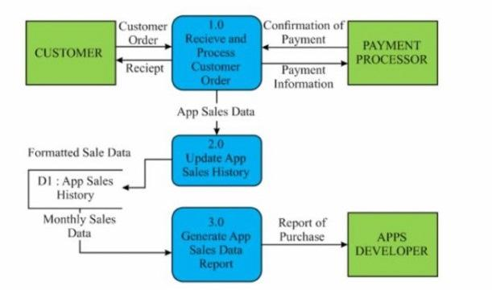
PROPOSED SYSTEM
BLOCK DIAGRAM

Slide 6
R DATA STRUCTURES USED
Data.frame : Store tabular data
List : Organize UI elements
Character vector : Hold text/string values
Factor : Ordered categories for plotting

Slide 7
LIST OF MODULES
User Authentication Module
CSV Upload & Validation Module
Sales Data Preview Module
Bar Chart Visualization Module
Line Chart Visualization Module

Slide 8
MODULES OF PROPOSED SYSTEM
User Authentication Module Handle login, signup, and logout using in-memory user database and reactive states.
CSV Upload Module Allow users to upload a CSV containing “Month” and “Sales” columns.
Data Validation Module Ensure uploaded CSV includes required columns; preprocess month factor levels.
Preview Module Display the first few rows of uploaded sales data in a table.
Bar Chart Plotting Module Generate a bar chart to visualize monthly sales using ggplot2.
Line Chart Plotting Module Generate a line graph to show sales trends across months.

Slide 9
CONCLUSION AND ADVANTAGES OF PROPOSED SYSTEM
CONCLUSION
The proposed Shiny app effectively combines user management, data upload, and interactive visualizations to support secure and insightful sales analysis. Its modular, user-friendly design makes it ideal for small businesses and analysts needing quick, lightweight data insights without complex tools.
ADVANTAGES
User Authentication
User-Friendly Interface
CSV Upload Flexibility
Data Validation

Slide 10


